Slide 1
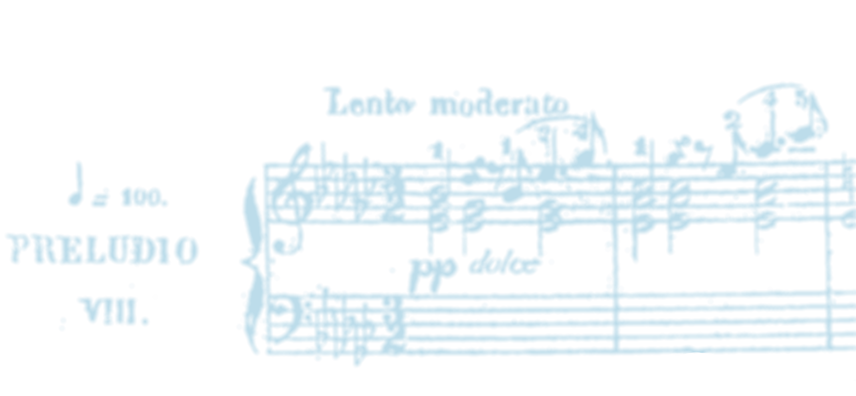
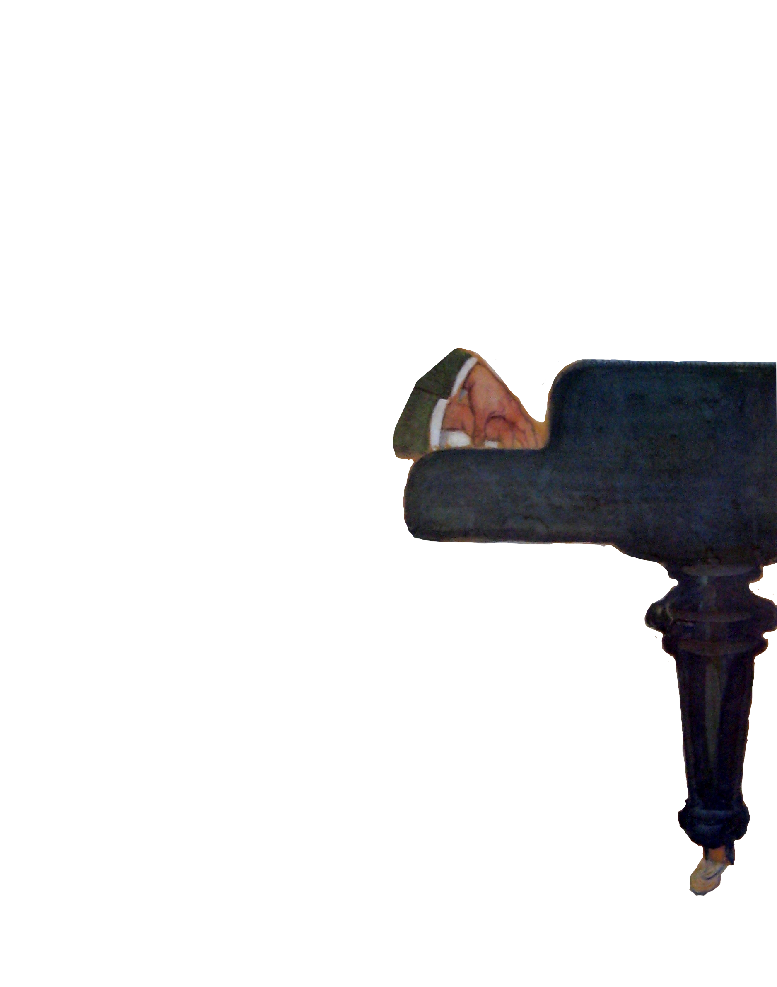



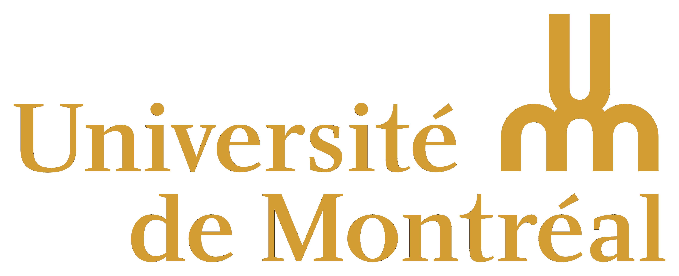
Echos du temps passé
Here comes a subtitle...
Nicholas Cornia
Viktor Lazarov
Notes:
Viktor plays a short extract before the starting of the presentation.

Slide 2
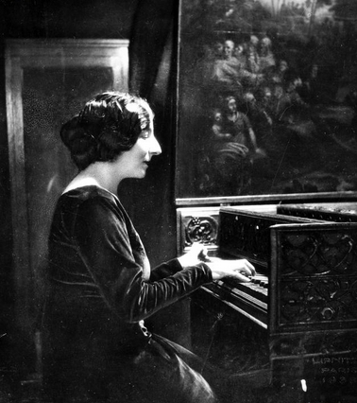
Plurality of interpretation
It would be wrong to pretend that there is only one interpretation, the right one.
Wanda Landowska
Echos du temps passé - AR@K symphosium 17-18 March 2025
Notes:
Questioning the concept of the "work": instead of seeking the right version, according to the composer's will, we should embrace the plurality of interpretations around it.
Our project wishes to illustrate this inherent, and exiting, plurality by considering two iconic keyboard works by J.S. Bach and Domenico Scarlatti.
We clarify this is a work in progress, and we are working on publish an extended article about our results.
P.s. See "decostruction of aura" by Walter Benjamin and Derrida, against the authoritative school of Hisher (Validity of Interpretation)

Slide 3
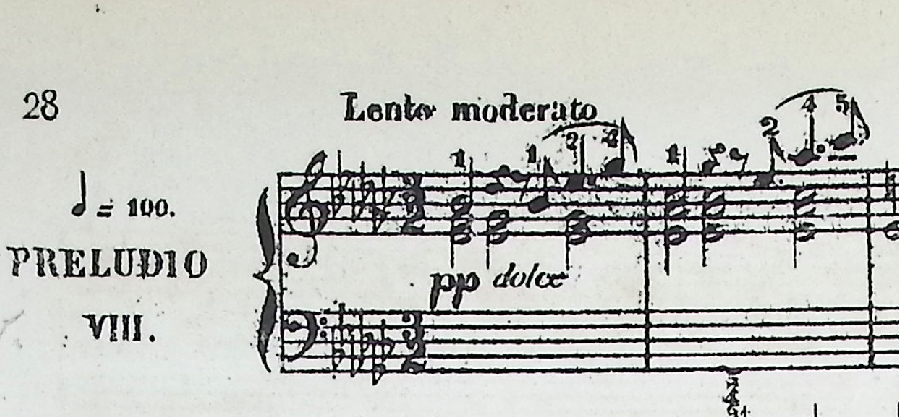
Corpus
Prelude N. 8 in Eb minor, BWV 853
Sonata in D minor, K.9
Echos du temps passé - AR@K symphosium 17-18 March 2025
Notes:
For the romantici, the keyboard music of Bach and Scarlatti have been a inexaustable source of inspiration and have been part of the training of generation of pianists around Europe.

Slide 4
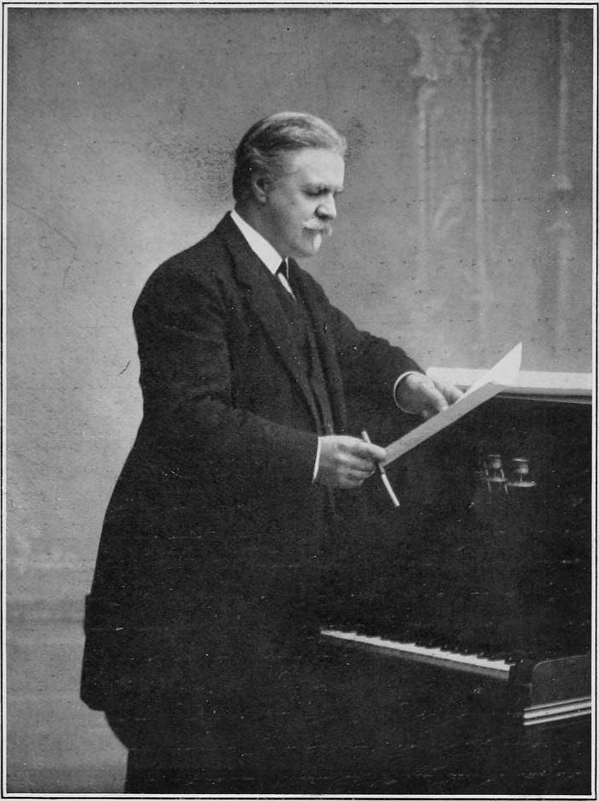
Bach...
For me, Bach is simply the father of all modern music.
Vincent d’Indy
Echos du temps passé - AR@K symphosium 17-18 March 2025

Slide 5
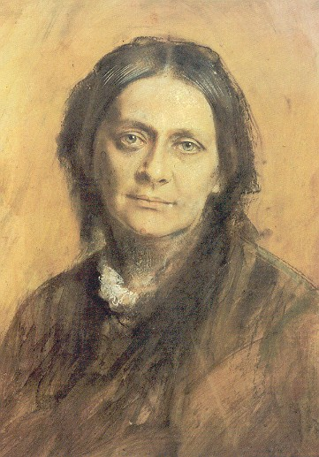
and Scarlatti
I am not over-fond of Scarlatti's music owing to the similarity of his pieces (in form and character). But I like to play individual pieces well enough and I happen to have a good volume of them. Think of the difference between possessing the Czerny edition and the splendid original.
Brahms to Clara Schumann
Echos du temps passé - AR@K symphosium 17-18 March 2025
Notes:
Johannes Brahms owned a copy of the Santini collection of Scarlatti Sonatas, and some of his annotated scores are preserved in the Gesellschaft der Musikfreunde in Vienna.
Similarly, the virtuoso pianist and composer Clara Schumann regularly played Scarlatti sonatas during her concerts.

Slide 6
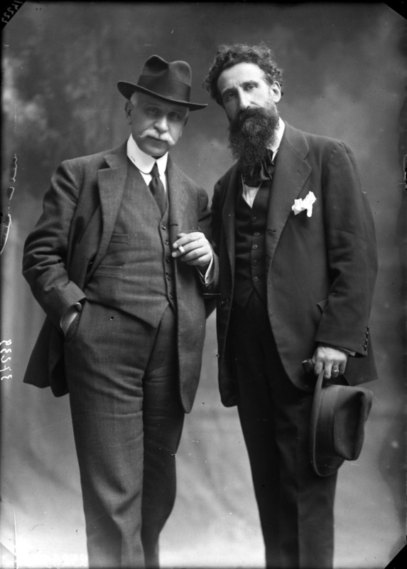
Editor's footprint
Even a perfect masterpiece, must be considered just a seed deposited in the soul of posterity.
Wanda Landowska
Alessandro Longo
Echos du temps passé - AR@K symphosium 17-18 March 2025
Notes:
Each editor made different choices according to their taste and musical tradition.
Similarly, baroque practice allowed for ambiguity and imagination.
So the pre-Urtext era editors just kept the original approach and mindset of these compositions, as works of art left open to interpretation and change.

Slide 7
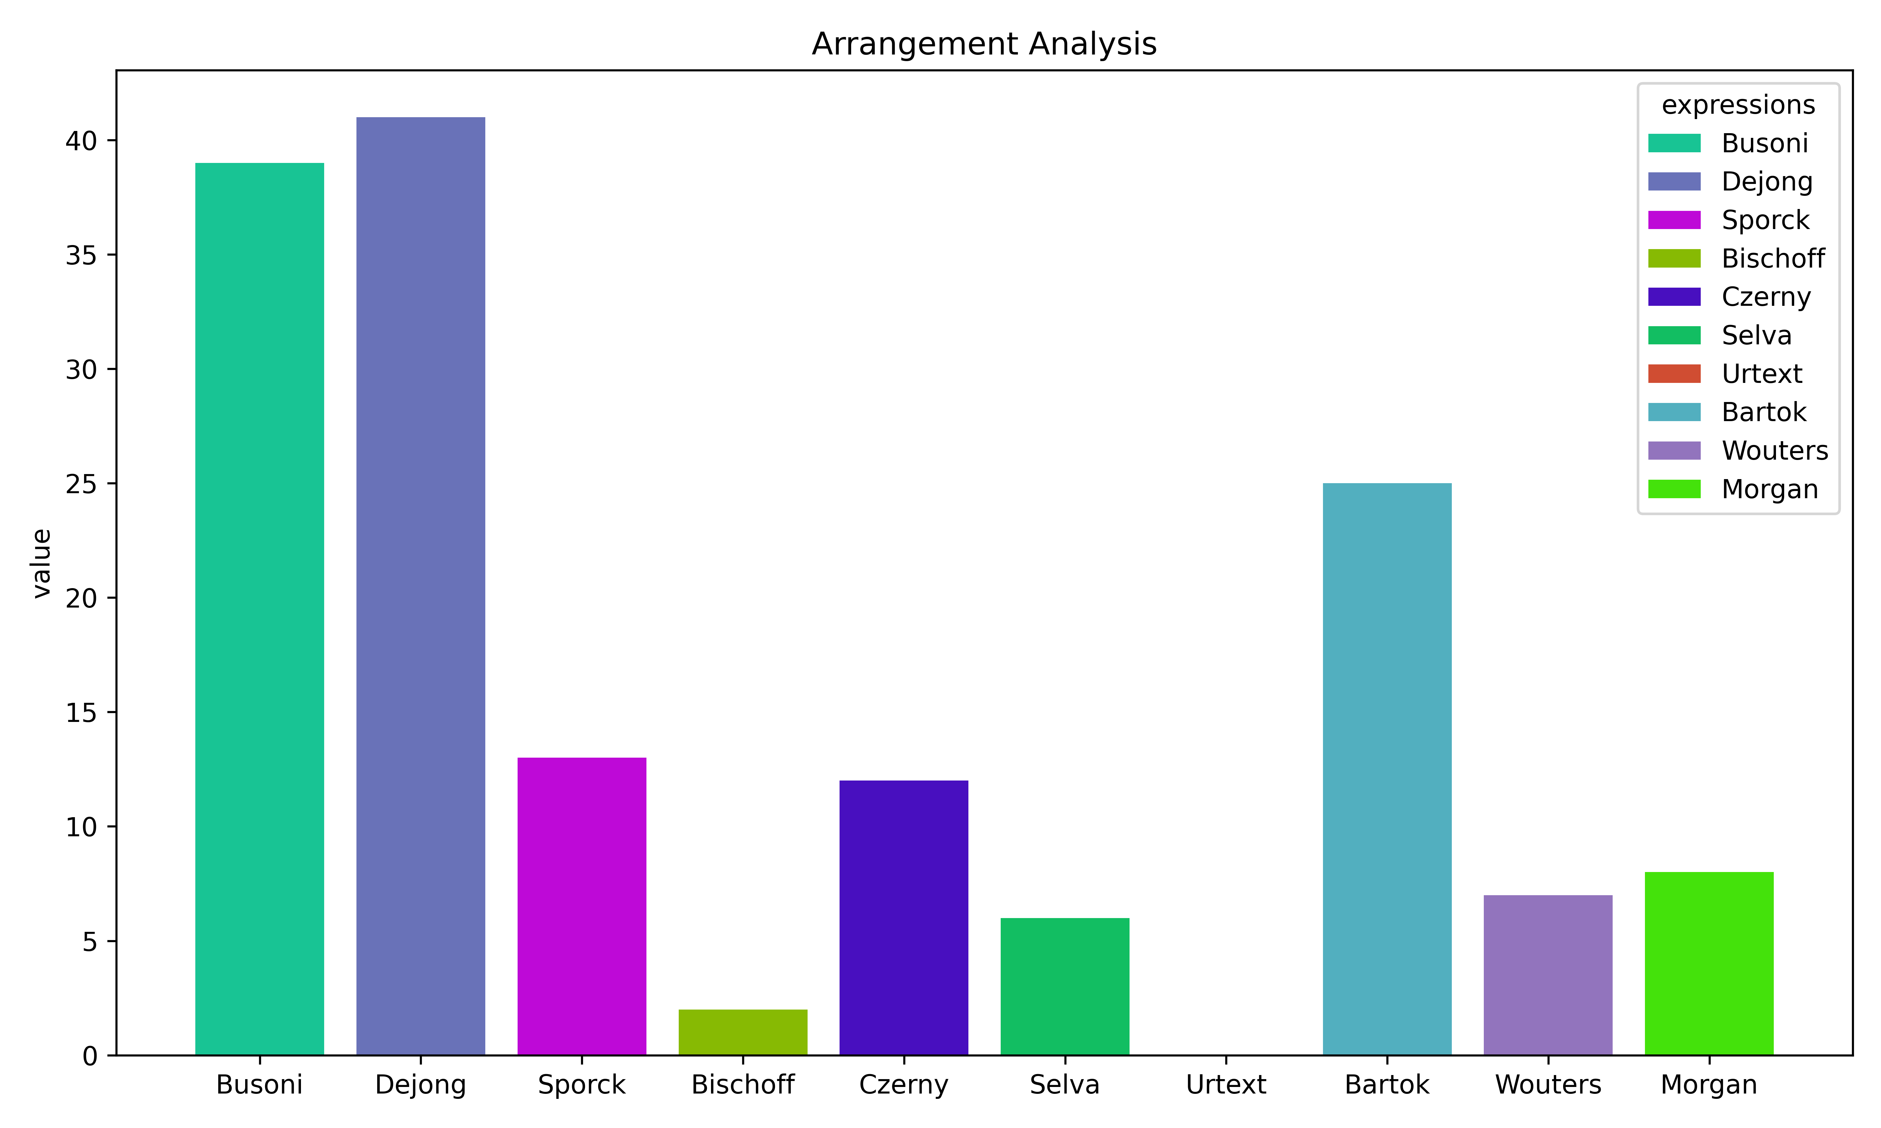
Some statistics...
Echos du temps passé - AR@K symphosium 17-18 March 2025
Notes:
Here comes the quantitative discussion. Let's consider one or two parameters for the Bach and Scarlatti and digress from them.

Slide 8
More statistics...
Echos du temps passé - AR@K symphosium 17-18 March 2025
Notes:
Here comes the quantitative discussion. Let's consider one or two parameters for the Bach and Scarlatti and digress from them.

Slide 9
Even more statistics...
Echos du temps passé - AR@K symphosium 17-18 March 2025

Slide 10

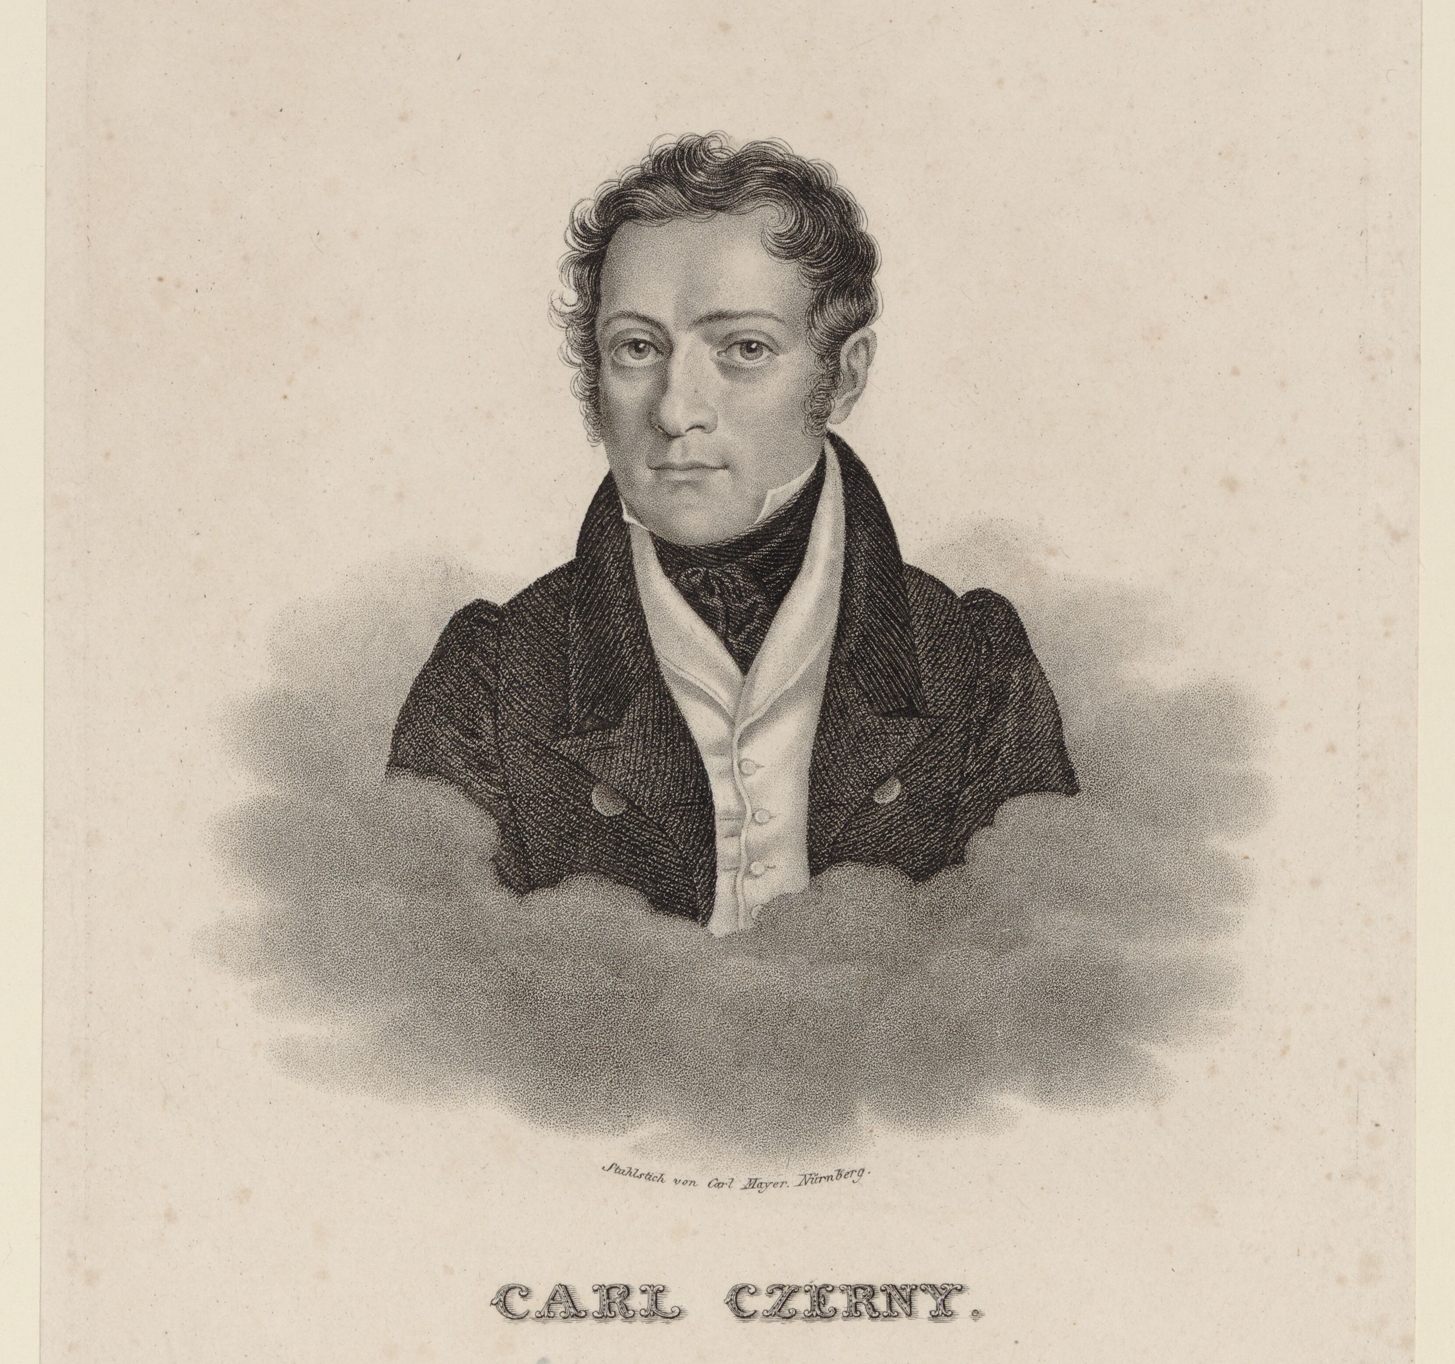
Analysis
The GitHub repository
Music XML analysis with Music21 Python library
MIDI Disklavier performances
Echos du temps passé - AR@K symphosium 17-18 March 2025
Notes:
Here comes some brief discussion about the analysis of the MusicXML transcriptions and the MIDI files from the Disklavier

Slide 11
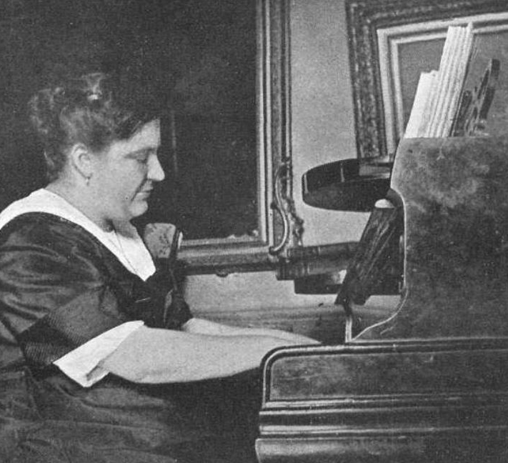
Legacy
We are not recapturing the masterpieces, the masterpieces themselves are recapturing us.
Wanda Landowska
Blanche Selva
Echos du temps passé - AR@K symphosium 17-18 March 2025
Notes:
Blanche Selva as music teacher and her legacy. The importance of Bach repertoire in her pedagogical mission.
Building an artistic network through these works.
Works of Bach and Scarlatti were addressing an audience of students and amateurs.
These editors were more explicit in their markings to clearly communicate their style.

Slide 12
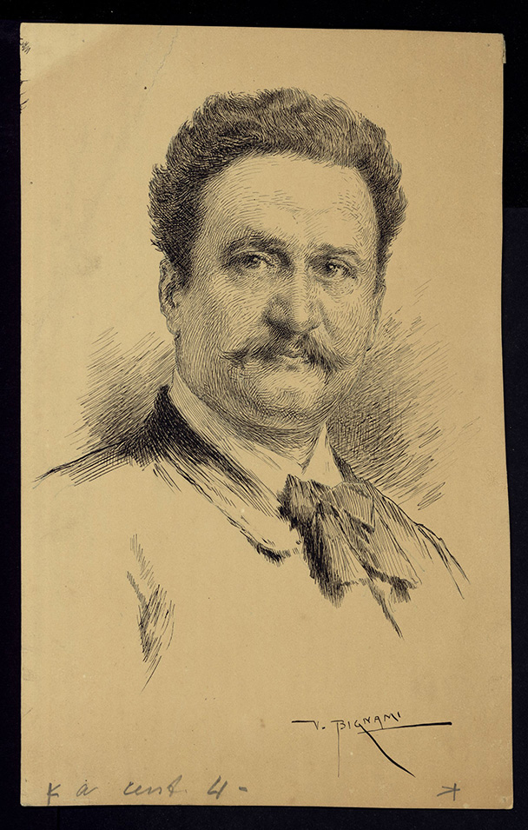
Future work
Extending the repertoire to other sonatas and preludes.
Complete recordings of all editions.
Giuseppe Buonamici
Echos du temps passé - AR@K symphosium 17-18 March 2025
Notes:
Blanche Selva as music teacher and her legacy. The importance of Bach repertoire in her pedagogical mission.
Building an artistic network through these works.
Works of Bach and Scarlatti were addressing an audience of students and amateurs.
These editors were more explicit in their markings to clearly communicate their style.

Slide 13
Thank you for your attention
Nicholas Cornia
Viktor Lazarov
Notes:
Viktor will play the pieces.

